Slide 1
Negative Messages
Lecture 9
Noreen shah

Slide 2
Three Step Writing Process: Negative messages
Negative messages can have as many as five goals:
• Give the bad news
• Ensure acceptance of the bad news
• Maintain the reader’s goodwill
• Maintain the organization’s good image
• Minimize or eliminate future correspondence on the matter, as appropriate

Slide 3
STEP 1: Planning A negative Message
Understanding your readers’ concerns helps you be sensitive their needs while delivering an effective message.
When preparing negative messages, choose the medium and channel with care.
Appropriate organization helps readers accept your negative news. (direct/indirect approach)
You need to consider a variety of factors when choosing between direct and indirect approaches for negative messages.
Do you need to get the reader’s attention immediately? If the situation is an emergency, or if someone has ignored repeated messages, the direct approach can help you get attention quickly.
Does the recipient prefer a direct style of communication? Some recipients prefer the direct approach no matter what, so if you know this, go with direct.
How important is this news to the reader? For minor or routine scenarios, the direct approach is nearly always best. However, if the reader has an emotional investment in the situation or the consequences to the reader are considerable, the indirect approach is often better, particularly if the bad news is unexpected.
Will the bad news come as a shock? The direct approach is fine for many business situations in which people understand the possibility of receiving bad news. However, if the bad news might come as a shock to readers, use the indirect approach to help them prepare for it.

Slide 4
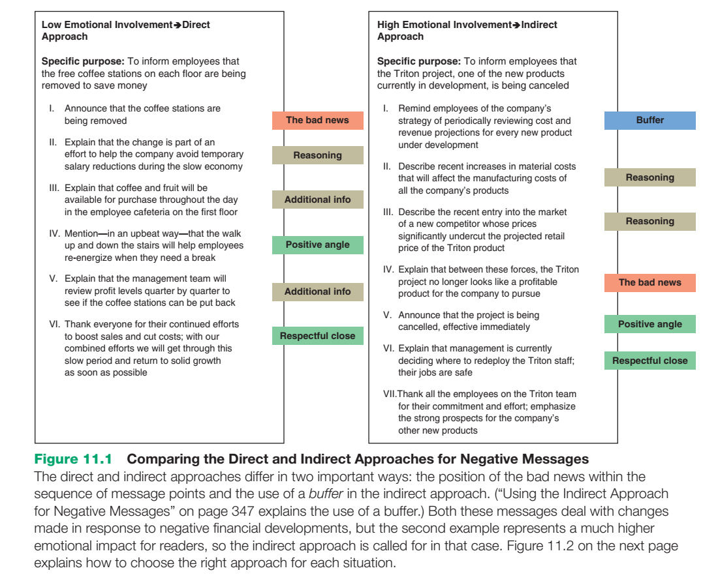

Slide 5
STEP 2: writing A negative Message
Writing clearly and sensitively helps take some of the sting out of bad news.
Protect your audience’s pride by using language that conveys respect.

Slide 6
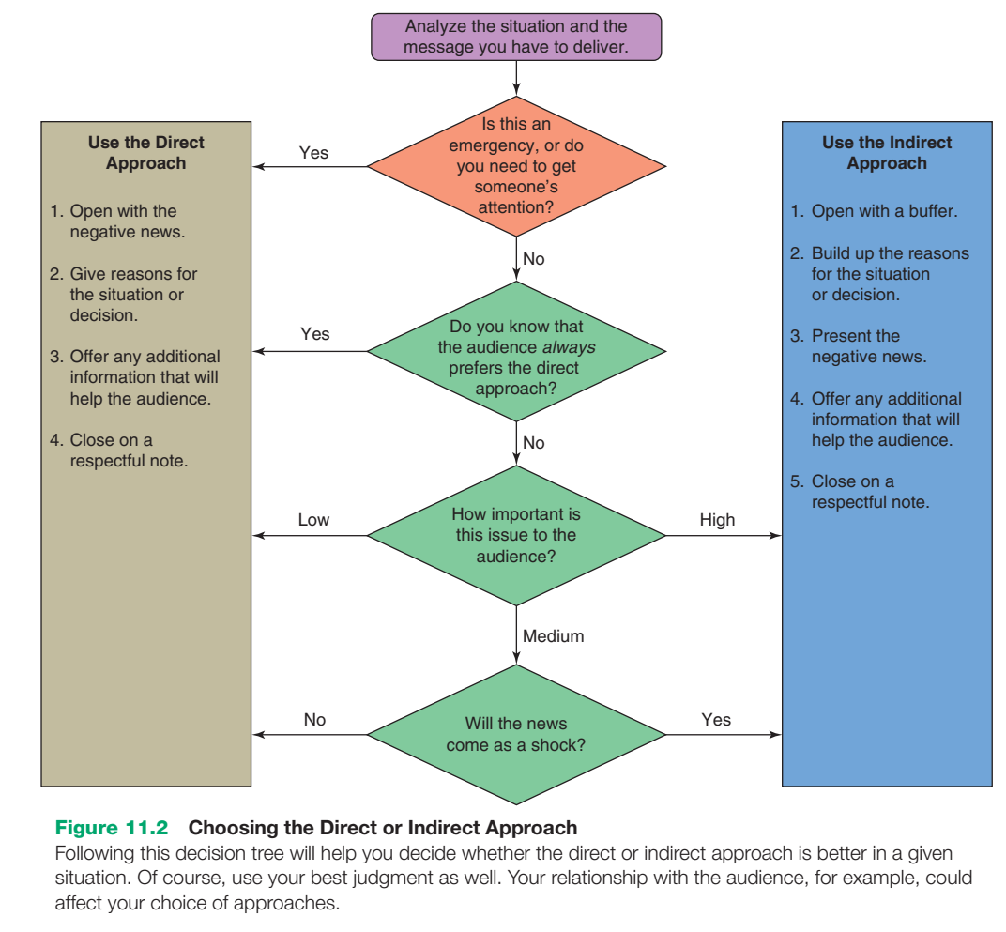

Slide 7
STEP 3: CoMPLETIng A nEgATIvE MESSAgE
The need for careful attention to detail continues as you complete your message. Revise your content to make sure everything is clear, complete, and concise. Even small flaws are likely to be magnified in readers’ minds as they react to the negative news, because they can create the impression that you are careless or incompetent. Produce clean, professional documents and proofread carefully to eliminate mistakes.

Slide 8
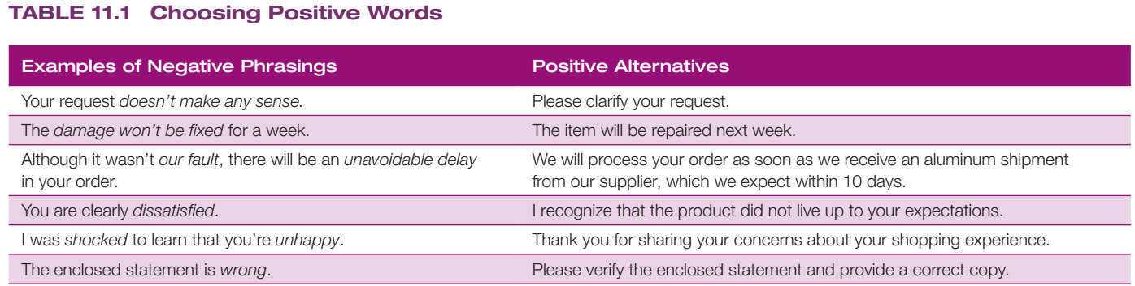

Slide 9
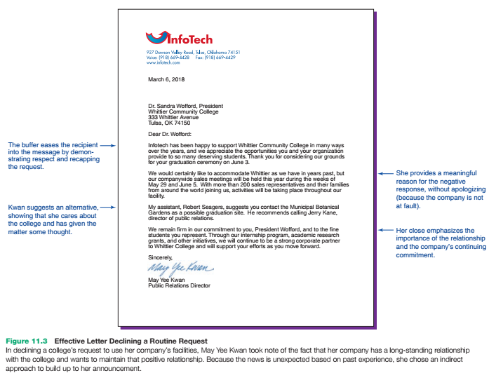

Slide 10
using the indirect approach for negative Messages
Consider these possible responses to a manager of the order-fulfillment department who requested some temporary staffing help from your department (a request you won’t be able to fulfill):
Our department shares your goal of processing orders quickly and efficiently.
As a result of the last downsizing, every department in the company is running shorthanded.
You folks are doing a great job over there, and I’d love to be able to help out.
Those new state labor regulations are driving me mad over here; how about in your department?
Establishes common ground with the reader and validates the concerns that prompted the original request—without
promising a positive answer Establishes common ground, but in
a negative way that downplays the recipient’s concerns
Potentially misleads the reader into concluding that you will comply with the request
Trivializes the reader’s concerns by opening with an irrelevant issue

Slide 11
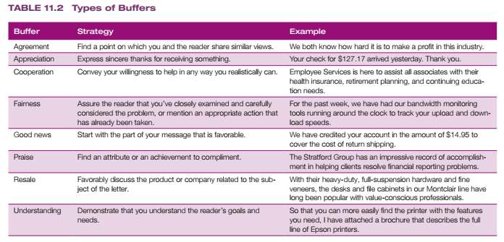

Slide 12
By sharing the reasons behind the policy (if appropriate in the circumstances), you can give readers a more satisfying answer. Consider this response to an applicant:
Because these management positions are quite challenging, the human resources department has researched the qualifications needed to succeed in them. The findings show that the two most important qualifications are a bachelor’s degree in business administration and two years’ super visory experience.
Shows the reader that the decision is based on a methodical analysis of the company’s needs and not on some arbitrary guideline
Establishes the criteria behind the decision and lets the reader know what to expect

Slide 13
This paragraph does a good job of stating reasons for the refusal:
●● It provides enough detail to logically support the refusal.
●● It implies that the applicant is better off avoiding a program in which he or she might fail.
●● It shows that the company’s policy is based on experience and careful analysis. ●● It doesn’t offer an apology for the decision because no one is at fault.
●● It avoids negative personal expressions (such as “You do not meet our requirements”).
Even valid, well-thought-out reasons won’t convince every reader in every situation. However, if you’ve done a good job of laying out your reasoning, you’ve done everything you can to prepare the reader for the main idea, which is the negative news itself.

Slide 14
After you’ve thoughtfully and logically established your reasons and readers are prepared to receive the bad news, you can use three techniques to convey the negative information as clearly and as kindly as possible. First, deemphasize the bad news:
●● Minimize the space or time devoted to the bad news—without trivializing it or withholding any important information.
●● Subordinate bad news in a complex or compound sentence (“My department is already shorthanded, so I’ll need all my staff for at least the next two months”). This construction presents the bad news in the middle of the sentence, the point of least emphasis.
●● Place bad news in the middle of a paragraph or use parenthetical expressions (“Our profits, which are down, are only part of the picture”).

Slide 15
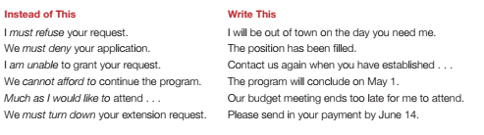
Just be sure to avoid overly blunt statements that are likely to cause pain and anger:

Slide 16
CLoSIng on A RESPECTFUL noTE
Whatever type of conclusion you use, follow these guidelines:
●● Avoid an uncertain conclusion. If the situation or decision is final, avoid statements such as “I trust our decision is satisfactory,” which imply that the matter is open to discussion or negotiation.
●● Manage future correspondence. Encourage additional communication only if you’re willing to discuss the situation further. (If you’re not, avoid statements such as “If you have further questions, please write.”)
●● Express optimism, if appropriate. If the situation might improve in the future, share that with your readers if it’s relevant. However, don’t suggest the possibility of a positive change if you don’t have insight that it might happen.
●● Be sincere. Steer clear of clichés that are insincere in view of the bad news. (If you can’t help, don’t say, “If we can be of any help, please contact us.”)

Slide 17
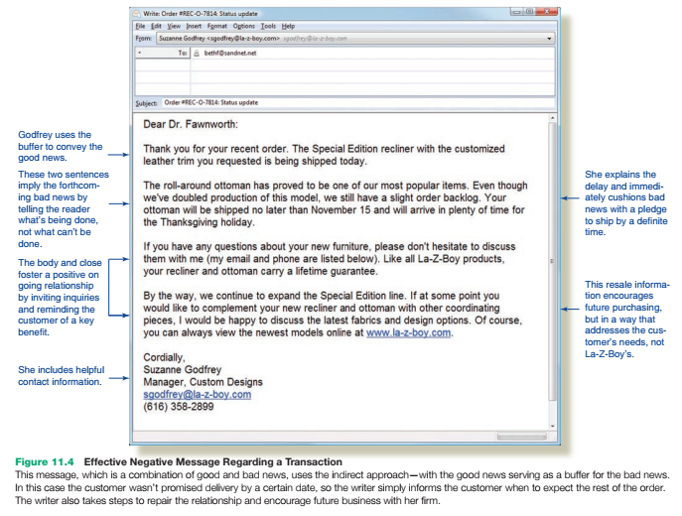

Slide 18
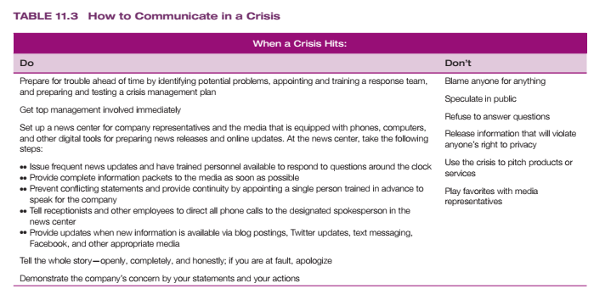

Slide 19
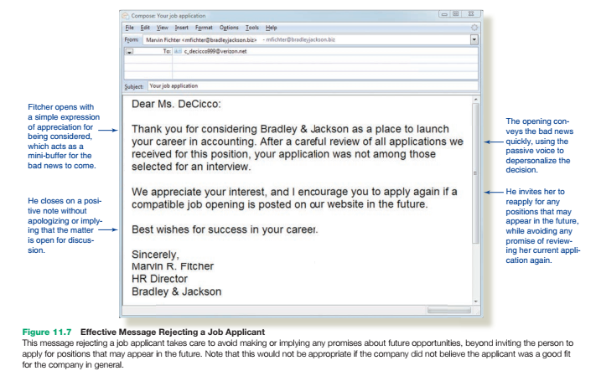

Slide 20
Messages for Analysis Read the following messages, then (1) analyze the strengths and weaknesses of each sentence and (2) revise each message so that it follows this chapter’s guidelines.
From: M. Juhasz, Travel & Meeting Services
To: [mailing list]
Subject: Travel
Dear Traveling Executives:
We need you to start using some of the budget suggestions we are going to issue as a separate memorandum. These include using videoconference equipment and web conferencing instead of traveling to meetings, staying in cheaper hotels, arranging flights for cheaper times, and flying from less-convenient but also less-expensive suburban airports.
The company needs to cut travel expenses by fifty percent, just as we’ve cut costs in all departments of Black & Decker. This means you’ll no longer be able to stay in fancy hotels and make last-minute, costly changes to your travel plans.
You’ll also be expected to avoid hotel surcharges for phone calls and Internet access. If the hotel you want to stay in doesn’t offer free wireless, go somewhere else. And never, NEVER return a rental car with an empty tank! That causes the rental agency to charge us a premium price for the gas they sell when they fill it up upon your return.
You’ll be expected to make these changes in your travel habits immediately.
Sincerely,
M. Juhasz Travel & Meeting Services

